Slide 1
Comprehensive Banking Analysis
By Guru Ragavendar

Slide 2
Problem Understanding
The objective of this project is to leverage advanced data analytics techniques, including classification, regression, and clustering, to extract valuable insights and enhance decision-making processes within the banking sector.
The project aims to address various aspects of banking operations, such as customer segmentation, credit risk assessment, and performance prediction.
This project aims to demonstrate the power of advanced analytics in optimizing various facets of banking operations, ultimately contributing to the overall success and sustainability of the financial institution

Slide 3
Solution
Predictive Model: Develop a machine learning model that can accurately predict the credit score of individuals based on their demographic and financial information as well as helpful in predicting the Total EMI’s of each individuals which would contribute to the banks profits
Data-driven Approach: Utilize historical data on individuals' credit profiles, including factors such as income, debt-to-income ratio, credit mix, payment history, length of credit history, etc.

Slide 4
Goal of the Project
Accurate Prediction: The primary goal is to accurately predict individuals' credit scores, enabling lenders and financial institutions to assess creditworthiness more effectively.
Risk Assessment: By accurately predicting credit scores and Total EMI’s, the goal is to help lenders evaluate the risk associated with extending credit to individuals, thereby reducing the likelihood of default and minimizing potential losses.
Enhanced Decision Making: Provide actionable insights to financial institutions to make informed decisions regarding loan approvals, interest rates, credit limits, and other financial products.

Slide 5
Benefits of this Project
Improved Lending Practices: By leveraging predictive analytics, financial institutions can make more informed decisions when evaluating loan applications, leading to more responsible lending practices and reduced default rates.
Increased Access to Credit: Accurate credit score prediction can help individuals with limited credit history or suboptimal credit scores gain access to credit on fairer terms, fostering financial inclusion and economic empowerment.
Cost Reduction: By automating the credit assessment process and reducing the need for manual review, financial institutions can lower operational costs and streamline their lending operations.
Customer Satisfaction: Providing individuals with transparent and fair credit assessments can enhance customer satisfaction and trust in financial institutions, leading to stronger customer relationships and loyalty.
Risk Mitigation: By accurately assessing credit risk, financial institutions can better mitigate the potential impact of loan defaults, leading to a more stable and resilient financial system.

Slide 6
EDA
The Profile Report of the banking dataset is given below

Slide 7
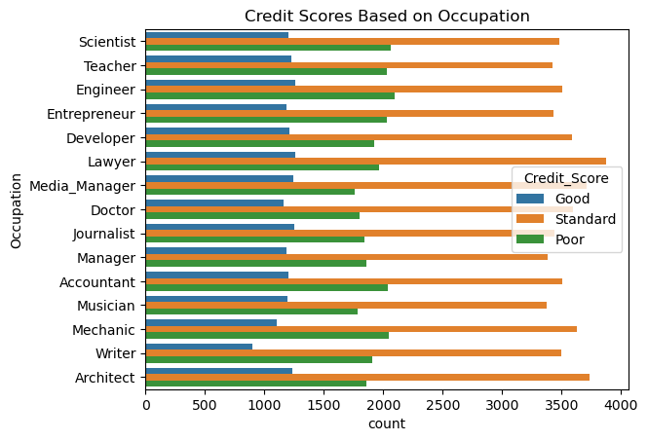

Slide 8
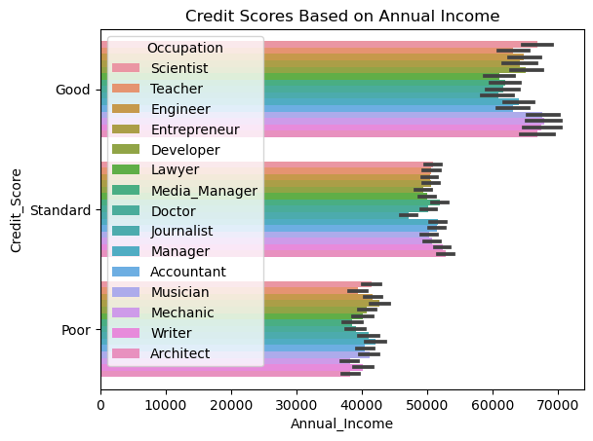

Slide 9
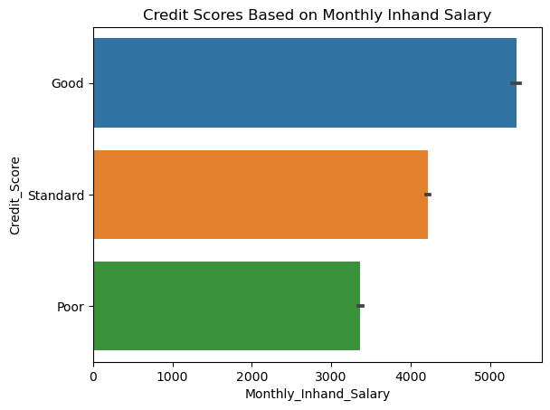
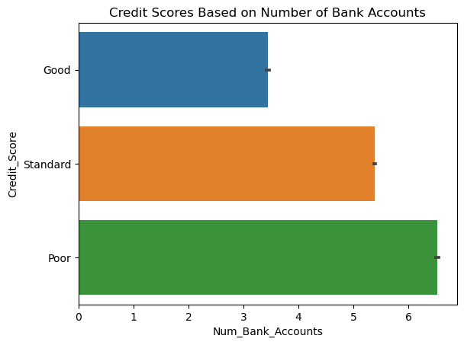

Slide 10
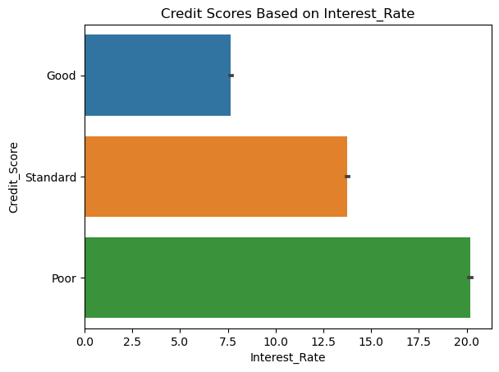
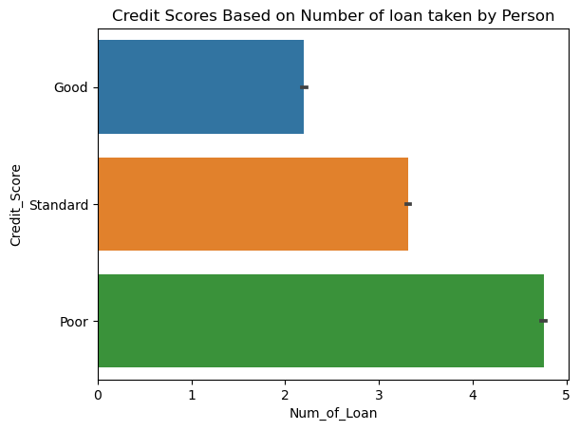

Slide 11
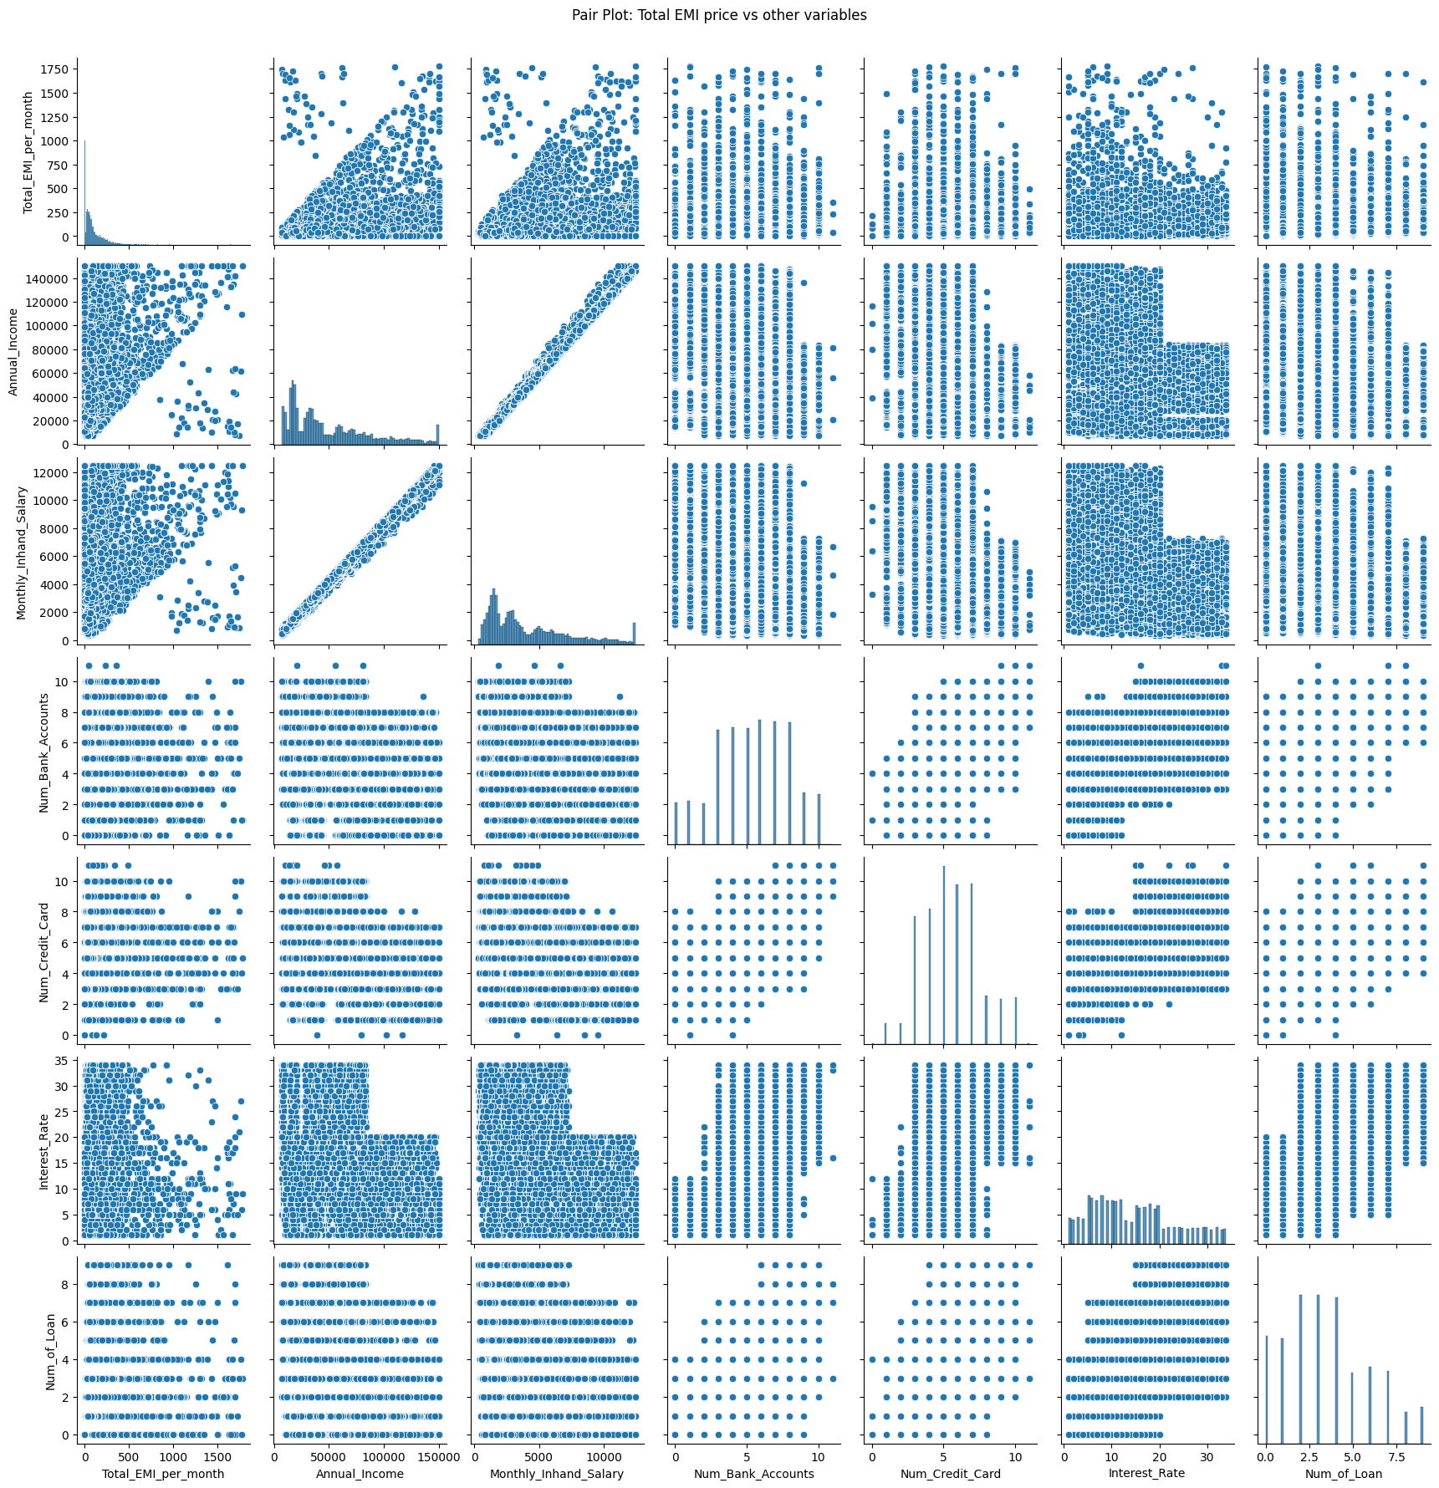

Slide 12
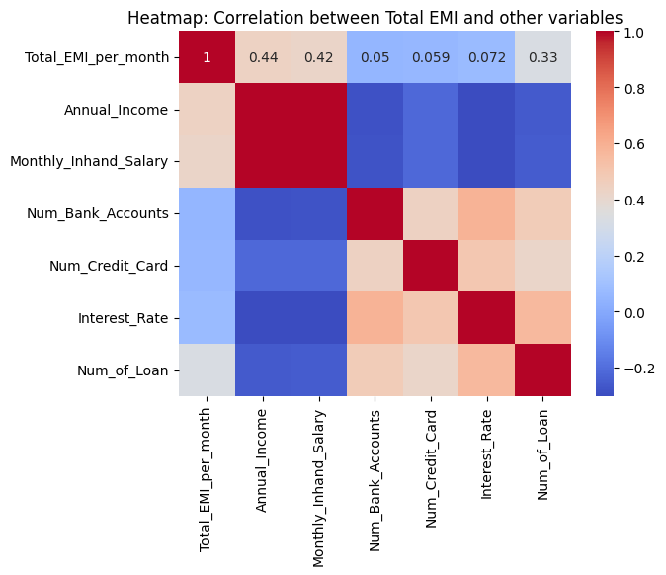

Slide 13
Diagnosis Analysis
Th Features such as Annual Income , Outstanding Debt Payment History, are all highly Correlated with the Target column Credit Score and Total EMI’s
The Credit Score of “Good” is treated as Positive class and “Standard” as ‘Neutra’ and “Bad “is treated as Negative classes respectively .
.There are no missing values identified but outliers do exist for certain numerical columns and require treatment
The categorical columns can be encoded using Label Encoder before parsing through model training

Slide 14
Clustering
Based on the banking behaviors, transaction histories, and demographics of the users the below columns are selected to be clustered:
'Age', 'Annual_Income', 'Monthly_Inhand_Salary',
'Num_Bank_Accounts', 'Num_Credit_Card', 'Interest_Rate', 'Num_of_Loan',
'Delay_from_due_date', 'Num_of_Delayed_Payment', 'Changed_Credit_Limit',
'Num_Credit_Inquiries', 'Credit_Mix', 'Outstanding_Debt',
'Credit_Utilization_Ratio', 'Credit_History_Age', 'Payment_of_Min_Amount',
'Total_EMI_per_month', 'Amount_invested_monthly', 'Payment_Behaviour',
'Monthly_Balance','Credit_Score'

Slide 15
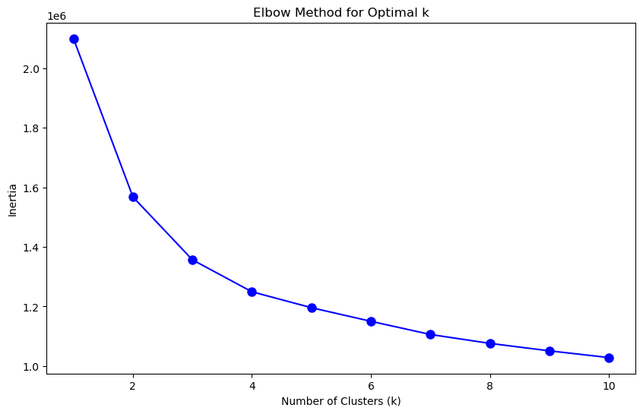
K means clustering
Using Elbow method the number of clusters to be formed are identified to be 4.

Slide 16
Model Selection for Classification problem
We are choosing the Random Forest Classifier as the best model for predicting the Credit Score as it has higher accuracy and F1 score grater than 0.8.
Algorithm | Accuracy | Precision | Recall | F1 score
Logistic Regression | 0.546030 | 0.523066 | 0.546030 | 0.492607
Decision Tree Classifier | 0.755848 | 0.755905 | 0.755848 | 0.755876
Random Forest Classifier | 0.806758 | 0.807084 | 0.806758 | 0.806736

Slide 17
Model Selection for Regression problem
We are choosing the Random Forest Regressor as the best model for predicting the Total EMI as it has lesser MSE and R2 score greater than 0.8.
Algorithm | Mean Absolute Error | Mean Squared Error | R-squared (R2) Score
LinearRegression | 54.439427 | 9211.734707 | 0.467240
DecisionTreeRegressor | 6.745819 | 3600.047175 | 0.791792
Random Forest Classifier | 9.995277 | 2788.090373 | 0.838751

Slide 18
Predictive Analysis For Classification
Credit Score Prediction for the following Data using Random Forest Classifier is:
Annual Income: 545545
Monthly In-hand Salary: 545
Number of Bank Accounts: 3
Number of Credit cards: 2
Interest rate: 7.5
Number of Loans: 2
Average number of days delayed by the person: 2
Number of delayed payments: 1
Credit Mix (Bad: 0, Standard: 1, Good: 3) : 1
Outstanding Debt: 0
Credit History Age: 0
Monthly Balance: 200
Predicted Credit Score = ['Standard’]

Slide 19
Predictive Analysis For Regression
Total EMI Prediction for the following Data using Random Forest Regressor is:
Annual Income: 545545
Monthly In-hand Salary: 545
Number of Bank Accounts: 3
Number of Credit cards: 2
Interest rate: 7.5
Number of Loans: 2
Average number of days delayed by the person: 2
Number of delayed payments: 1
Credit Mix (Bad: 0, Standard: 1, Good: 3) : 1
Outstanding Debt: 0
Credit History Age: 0
Monthly Balance: 200
Predicted Total EMI= [837.73131204]

Slide 20
Prescriptive analysis
Improve Payment Behavior: Encourage individuals to make timely payments on their loans and credit cards to avoid late fees and negative impacts on their credit scores. Setting up automatic payments or reminders can help.
Reduce Debt: Advise individuals to pay down outstanding debt, especially high-interest debt like credit card balances. Lowering debt-to-income ratios can positively influence credit scores.
Diversify Credit Mix: Suggest diversifying credit types by responsibly using different forms of credit, such as installment loans, credit cards, and mortgages, to demonstrate creditworthiness.
Monitor Credit Report: Recommend regularly checking credit reports for errors or inaccuracies and disputing any discrepancies. Monitoring credit utilization and maintaining low balances on credit cards can also be beneficial.
Customer Retention: Implement targeted marketing campaigns to retain high-value customers based on churn prediction models.

